Slide 1
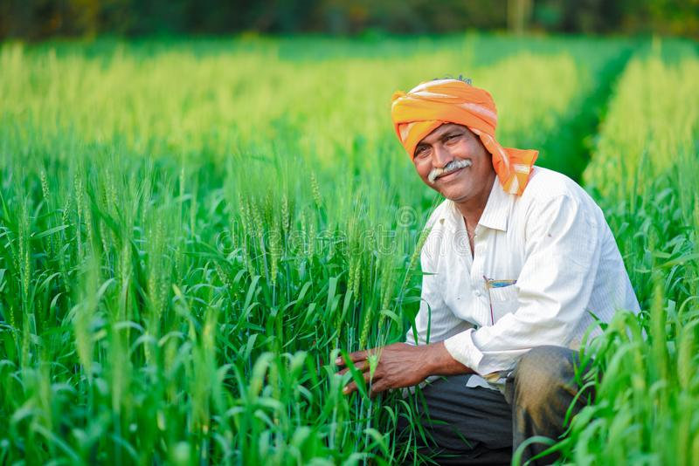
Crop Guidance and Farmer’s friend

Slide 2

team
1) Vidhi Gambhir
2) Aditya Pratap singh
3) Rakesh kumar
4) Ritik jain
5) Ritik Chaudhary

Slide 3
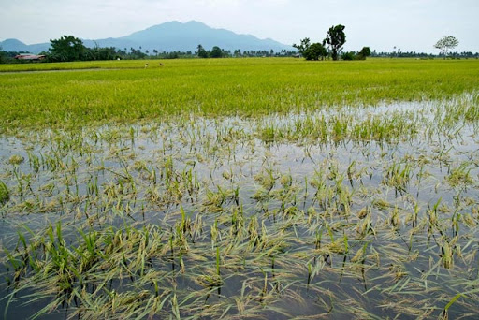
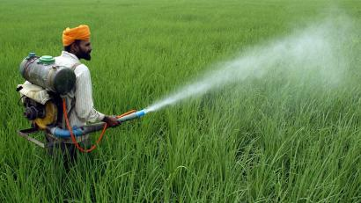
Problem title:
Helping the farmers in terms of Crop suggestion, precautions based on the met department forecast of rain fall / weather, potential pest attacks , weather warnings etc.

Slide 4
Detailed problem:
It is going to provide details to farmers on weather patterns that could impact the crop, possible pest attacks.
Information of crops according to soil and region.
How to be well prepared if there is pest, insect attack.
Suitable method of farming according to crops.

Slide 5
Benefits of solution:
Better crops production and farmers have better income
High yield and prescriptive guidance

Slide 6
Technology:
. ANDROID DEVELOPMENT USING JAVA AND KOTLIN.

Slide 7
Development map:
initialization:-
iN order to the create the best and most useful farm guide possible ,we need to collect loads of detailed data on each and every aspect related to farming .
from weather to pests, sowing to harvesting , data that was indeed really necessary in order to get the most out of farming needs to be collected.
Design:-
the application is created such that each and every crop is categorized . the user has the freedom to directly search for a specific crop ,he can also search and choose which crop will be better for the season or region he wants to farm in.

Slide 8
THEN WE NEED TO LINK THE COLLECTED DATA TO ITS RESPECTIVE CATEGORY AND TO THE SEARCH BOX.
THIS WILL MAKE OUR FARM GUIDE COMPLETELY WORKING.
POSSIBLE UPDATES:-
. AFTER CREATING THE BASIC WORKING MODEL OF THE APPLICATION WE WILL ADD FEATURES TO IT,THAT CAN BE.
. A NOTEPAD AND CHOOSE LIST FOR FARMERS TO WORK ON.
. INDIVISUAL ID CREATION FOR A PARTICULAR FARMER.
. SUGGESTIONS FOR THE CROP TO SOW.
. WEATHER FORCAST COLUMN.
.PEST CONTROL DETAILS.

